Slide 1
ML Classification
UIUC ECON 490: Applied Machine Learning in Economics

Slide 2
Overview
KNN
Data-driven method
No inference!
Uses
Regression problems
Classification problems
Naïve Bayes
Model-driven method
Bayes theorem
No inference!
Uses
Classification problems

Slide 3
K-Nearest Neighbors
Data-Driven Algorithm

Slide 4
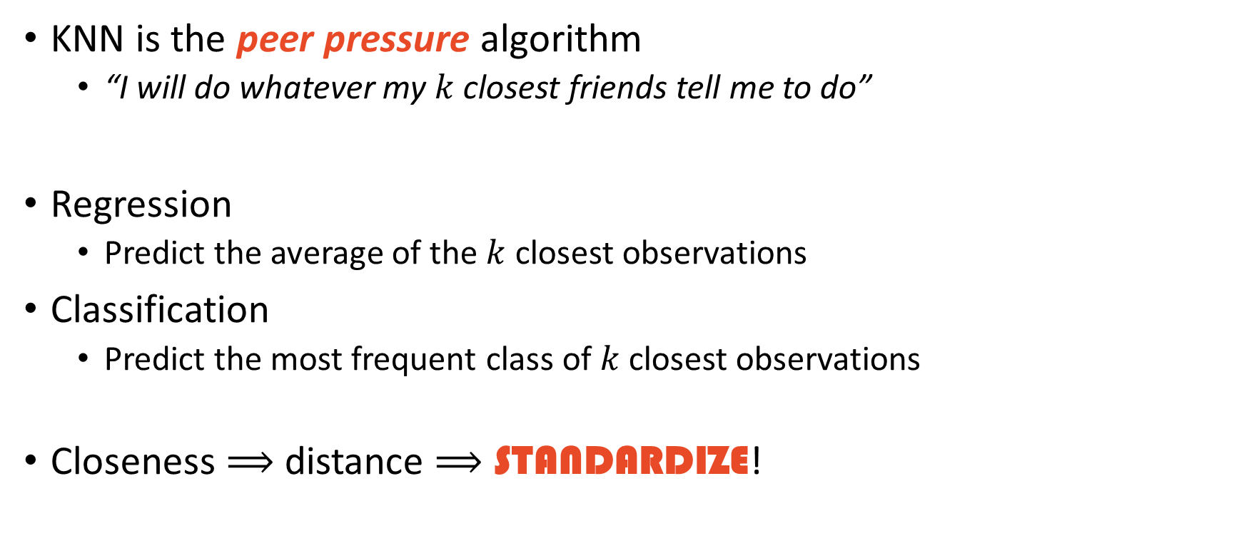
KNN Intuition
KNN is the peer pressure algorithm
“I will do whatever my $k$ closest friends tell me to do”
Regression
Predict the average of the $k$ closest observations
Classification
Predict the most frequent class of $k$ closest observations
Closeness $⟹$ distance $⟹$ STANDARDIZE!

Slide 5
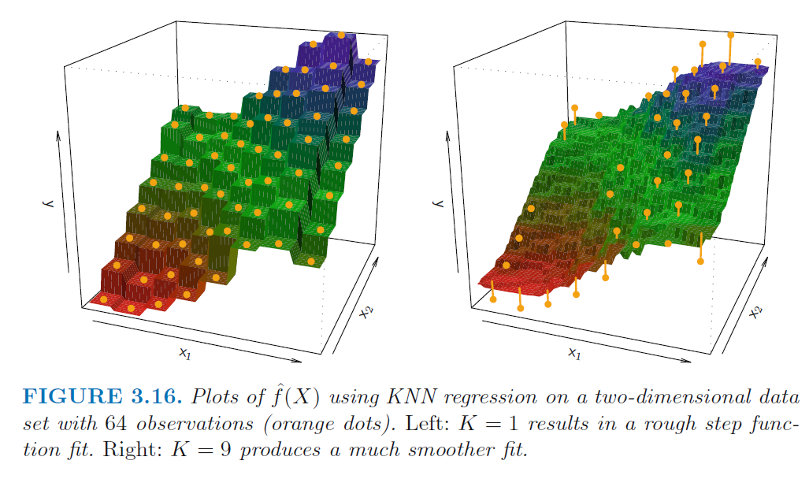

KNN for Regression
$$\hat{y}=\frac{1}{K}\sum_{i∈N_{0}}^{​}{y_{i}}$$
$N_{0}$ - $K$ nearest observations
Nonlinear predictor
Source: Introduction to Statistical Learning

Slide 6
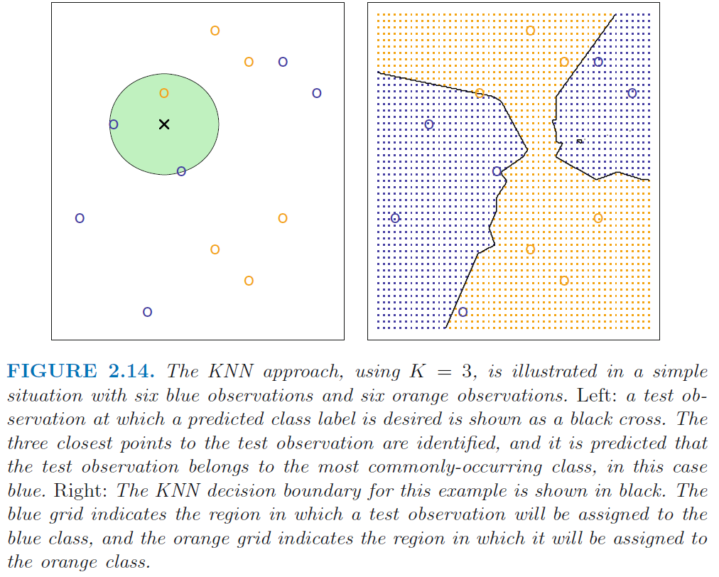
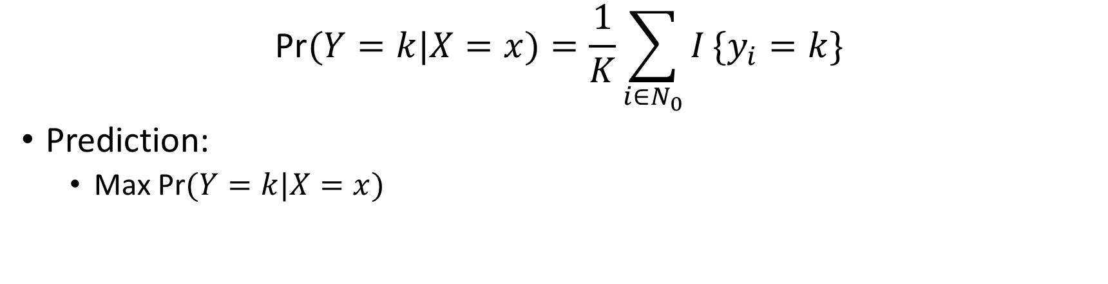
KNN for Classification
$$\text{Pr}(Y=k|X=x)=\frac{1}{K}\sum_{i∈N_{0}}^{​}{I}\{y_{i}=k\}$$
Prediction:
Max $\text{Pr}(Y=k|X=x)$
Source: Introduction to Statistical Learning

Slide 7

Question
As the value of $k$ decreases, the flexibility __________.

Slide 8
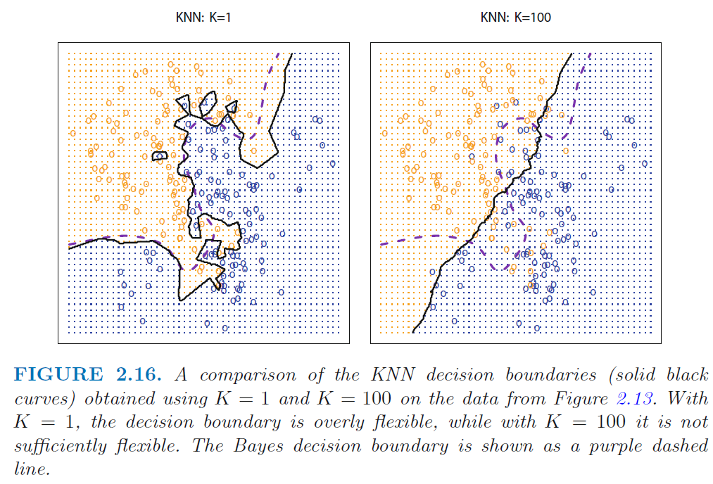
Answer
Source: Introduction to Statistical Learning

Slide 9
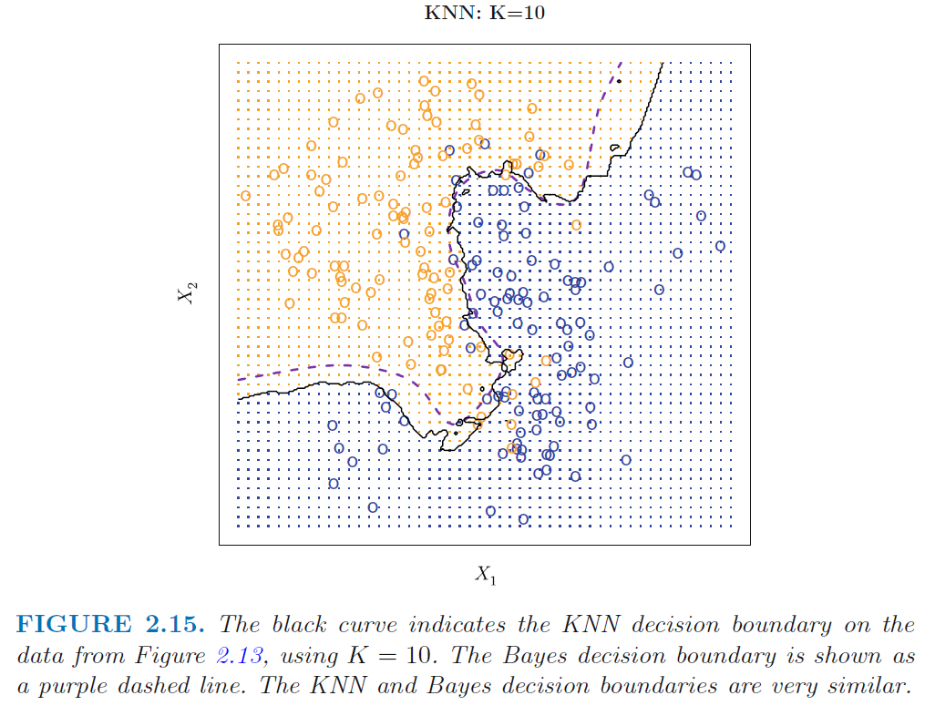
How do we choose $k$?
Cross-validation!!
Source: Introduction to Statistical Learning

Slide 10
Naïve Bayes
Probabilistic classification

Slide 11
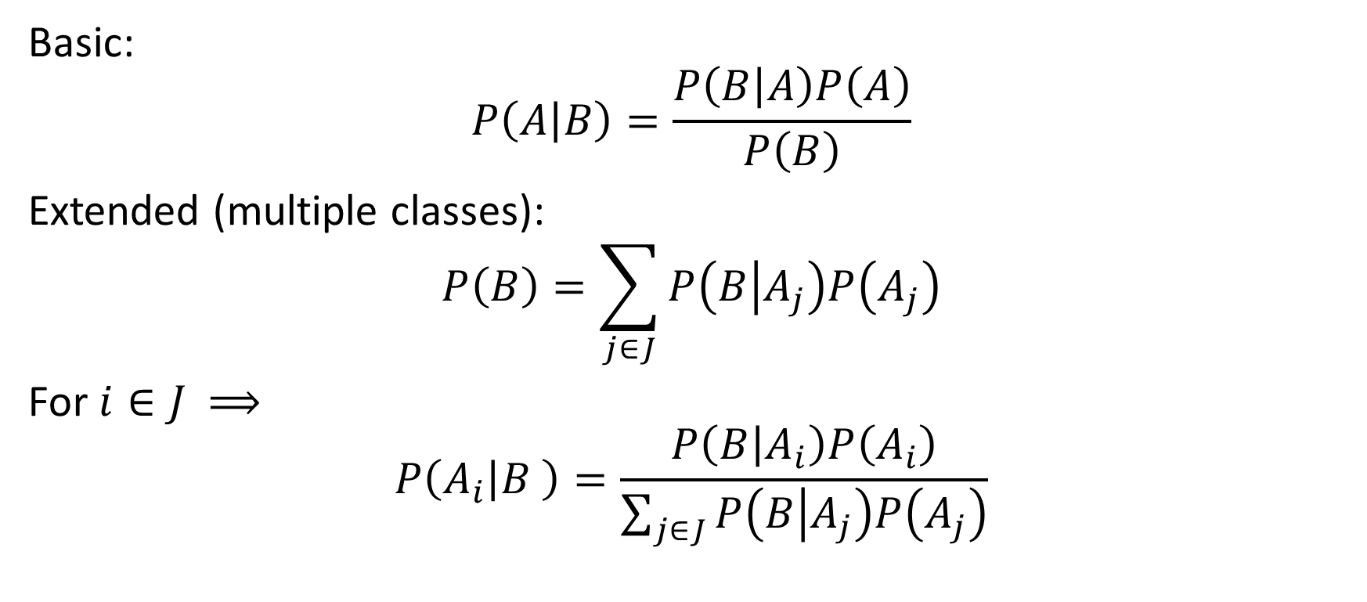
Bayes Theorem - Formulas
Basic:
$$P\left(A | B\right)=\frac{P\left(B | A\right)P\left(A\right)}{P\left(B\right)}$$
Extended (multiple classes):
$$P\left(B\right)=\sum_{j∈J}{P\left(B | A_{j}\right)P\left(A_{j}\right)}$$
For $i∈J$ $⟹$
$$P\left(A_{i} | B \right)=\frac{P\left(B | A_{i}\right)P\left(A_{i}\right)}{\sum_{j∈J}{P\left(B | A_{j}\right)P\left(A_{j}\right)}}$$

Slide 12
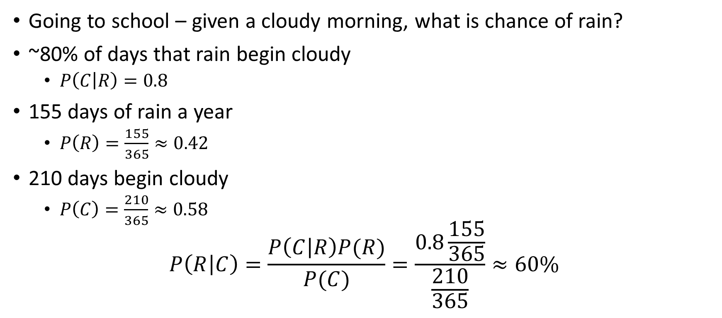
Example – Growing up in Seattle
Going to school – given a cloudy morning, what is chance of rain?
~80% of days that rain begin cloudy
$P\left(C | R\right)=0.8$
155 days of rain a year
$P\left(R\right)=\frac{155}{365}≈0.42$
210 days begin cloudy
$P\left(C\right)=\frac{210}{365}≈0.58$
$$P\left(R | C\right)=\frac{P\left(C | R\right)P(R)}{P(C)}=\frac{0.8\frac{155}{365}}{\frac{210}{365}}≈60\%$$

Slide 13

Naïve Bayes
$$P\left(C_{k} | x\right)=\frac{P\left(x | C_{k}\right)P(C_{k})}{P(x)}$$
$$Posterior=\frac{likelihood∗prior}{evidence}$$
$P(x)$ is constant $⟹$
$$P\left(C_{k} | x\right)∝P\left(x | C_{k}\right)P\left(C_{k}\right)$$
Note: $P(C_{k})$ is obtained from data

Slide 14
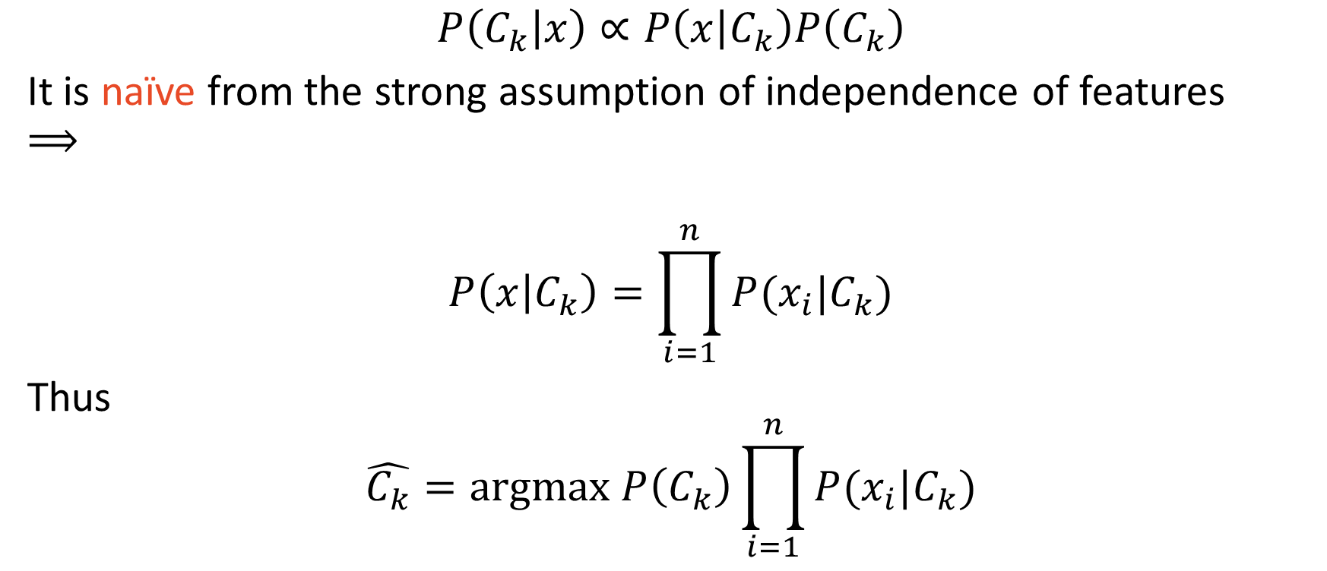
Naïve Bayes
$$P\left(C_{k} | x\right)∝P\left(x | C_{k}\right)P\left(C_{k}\right)$$
It is naïve from the strong assumption of independence of features $⟹$
$$P\left(x | C_{k}\right)=\prod_{i=1}^{n}{P(x_{i}|C_{k})}$$
Thus
$$\hat{C_{k}}=argmax P\left(C_{k}\right)\prod_{i=1}^{n}{P(x_{i}|C_{k})}$$

Slide 15
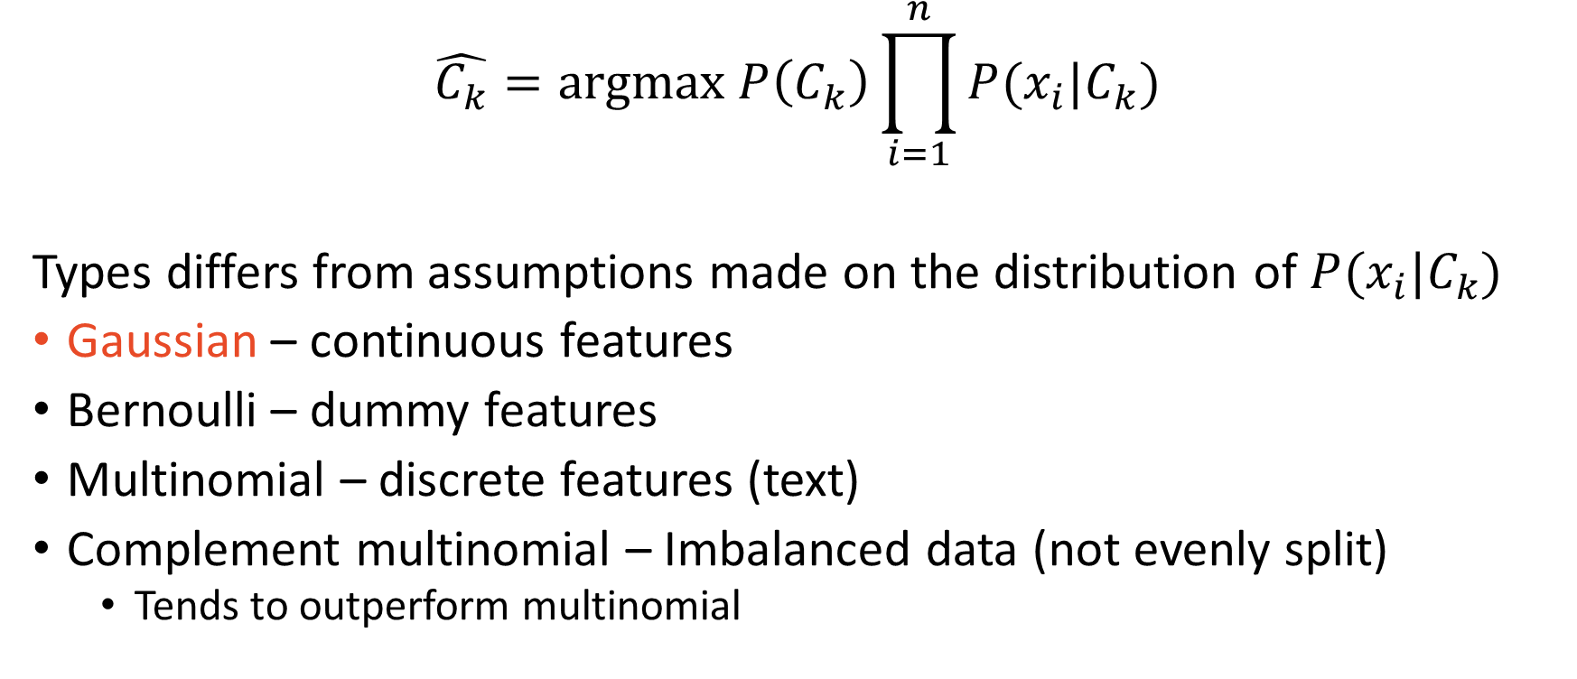
Naïve Bayes Classifiers
$$\hat{C_{k}}=argmax P\left(C_{k}\right)\prod_{i=1}^{n}{P(x_{i}|C_{k})}$$
Types differs from assumptions made on the distribution of $P(x_{i}|C_{k})$
Gaussian – continuous features
Bernoulli – dummy features
Multinomial – discrete features (text)
Complement multinomial – Imbalanced data (not evenly split)
Tends to outperform multinomial

Slide 16

Questions?

